Slide 1

SMART VECHICLE BREAKDOWN SYSTEM
SOA Project Review-1
Date& Time
Team Members Name: J. Lasya Geethika Roll Number : 2420030686 Name: J. Sree Vardhini Roll Number : 2420030677 Name: P. Harshini Roll Number : 2420030323
 | Under the Guidance of Venkateshwari Department of Computer Science and Engineering, KLH CSE Bowrampet Campus

Slide 2

Outline of Project Work
Focus
Introduction
Literature Survey
Challenges
Research Objectives
Conclusion & Future Work
References
Publications Details

Slide 3
Introduction
Vehicle breakdowns can happen suddenly and unexpectedly, often in unfamiliar or remote locations.
Manually searching for and contacting nearby mechanics can waste valuable time during a stressful situation.
Traditional roadside assistance often depends on scattered phone calls, with little visibility into the status
of the request.
A centralized, location-aware platform can quickly and reliably connect drivers with the right assistance.
w can vehicle owners quickly and efficiently obtain suitable roadside assistance during unexpected breakdowns using location-based matching, centralized request management, and real-time status tracking?
How can vehicle owners quickly and efficiently obtain suitable roadside assistance during unexpected breakdowns using location-based matching, centralized request management, and real-time status tracking?

Slide 4
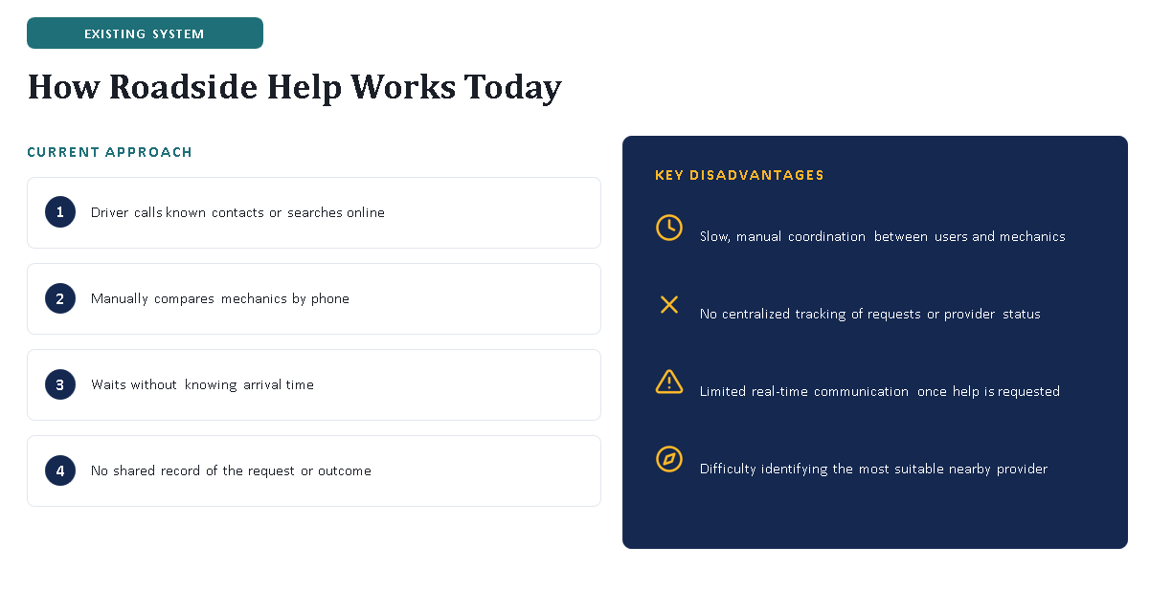
Introduction
w can vehicle owners quickly and efficiently obtain suitable roadside assistance during unexpected breakdowns using location-based matching, centralized request management, and real-time status tracking?
How can vehicle owners quickly and efficiently obtain suitable roadside assistance during unexpected breakdowns using location-based matching, centralized request management, and real-time status tracking?

Slide 5
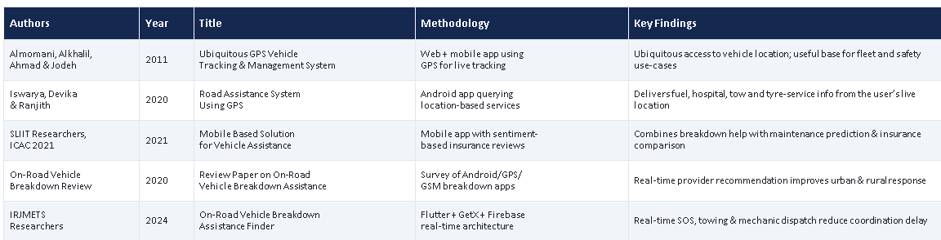
Literature Survey
Authors | Title of the Paper | Methodology | Inferences | Limitation/Future work
Hilal et. al. [3] |  | Coyote optimization algorithm (COA) for feature selection Krill herd algorithm (KHA) for parameter tuning | intelligent deep canonical sparse autoencoder-based epileptic seizure detection and classification model using EEG signals. It achieves a maximum accuracy of 98.67% and 98.73% under binary and multi-classification, respectively. | The paper does not mention the specific limitations of the proposed DCSAE-ESDC technique or the experimental analysis conducted using the benchmark epileptic seizure dataset

Slide 6
Problem Statement
How can vehicle owners quickly and efficiently obtain suitable roadside assistance during unexpected breakdowns using location-based matching, centralized request management, and real-time status tracking?

Slide 7
Objectives
To innovate a centralized platform for efficient vehicle breakdown assistance.
To develop a digital system for reporting vehicle breakdowns with type, description, and images.
To enable accurate real-time GPS location tracking during breakdown requests.
To automatically identify and match users with suitable nearby service providers.
To reduce vehicle assistance response time compared to traditional manual methods.
To enable service providers to accept, navigate, and manage assigned assistance requests.
To provide real-time tracking of assistance status from Pending to Accepted, In Progress, and Completed.
To improve coordination and communication between vehicle users and service providers.

Slide 8
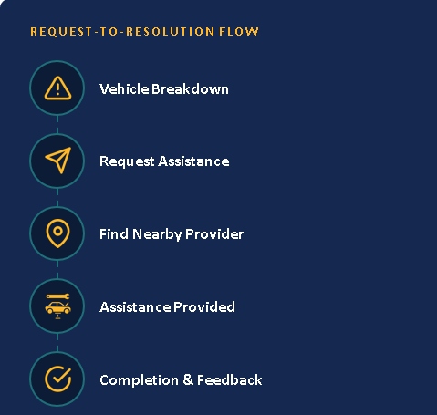
Problem Gap Identification
1. Manual Calling
Calling multiple mechanics takes time and delays assistance. Our system provides a quick digital request.
2. No Intelligent Matching
Drivers may struggle to find the right mechanic. Our system matches them with suitable nearby providers.
3. No Centralized Tracking
Users cannot easily track their request. Our system provides real-time status updates.
4. Poor Coordination
Multiple communication channels can cause confusion. Our centralized platform improves coordination.
5. Limited Location Support
Finding the exact location of a stranded vehicle can be difficult. GPS helps providers locate users accurately.
6. Manual Records
Managing records manually is difficult. Our database stores requests and service details efficiently.

Slide 9
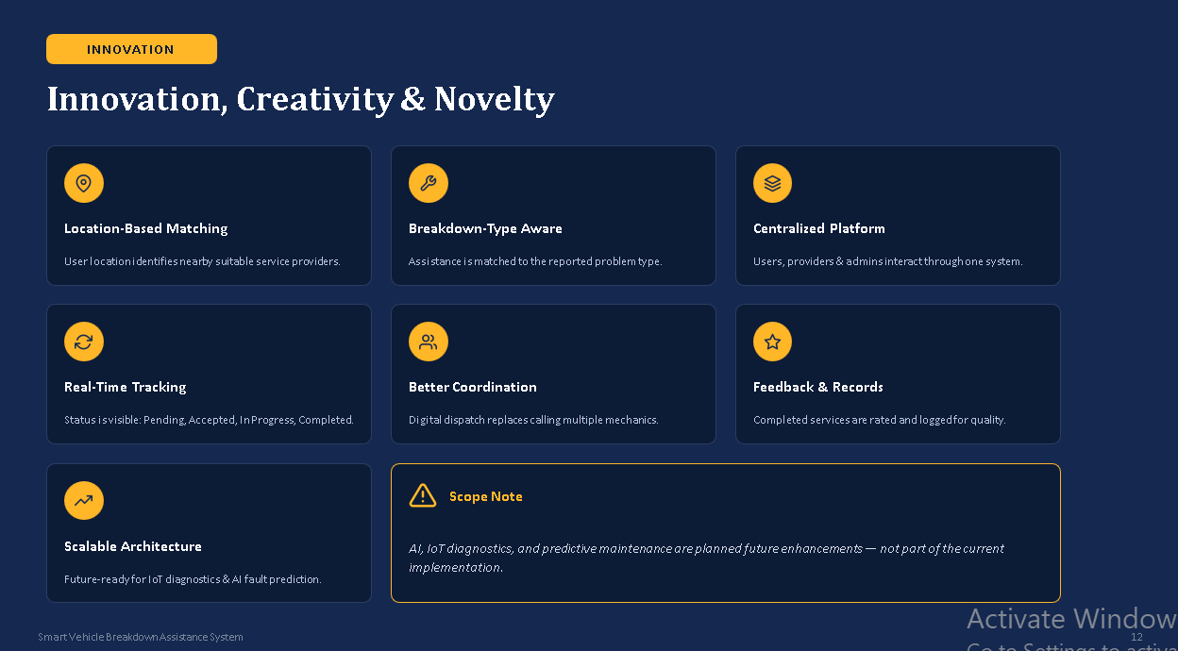
Innovation, Creativity, and Novelty

Slide 10
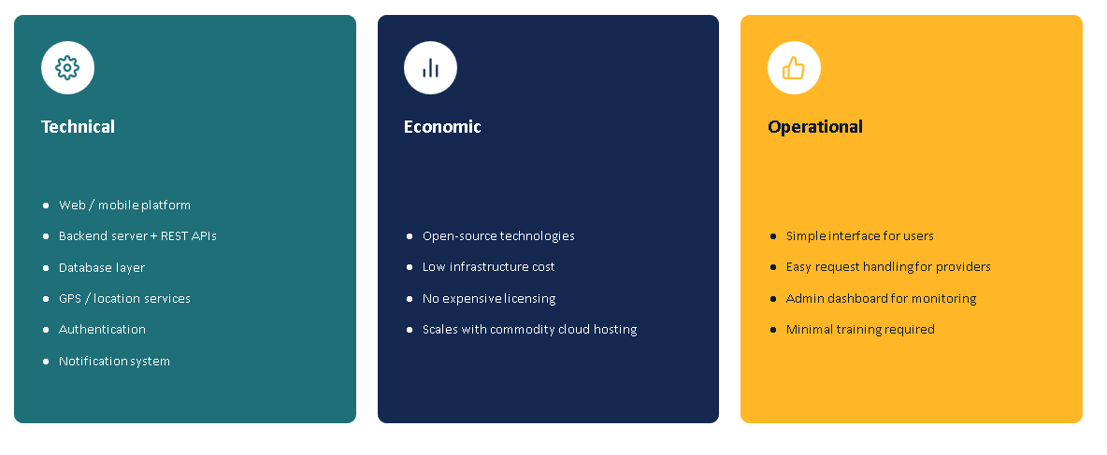
Feasibility and Project Plan

Slide 11
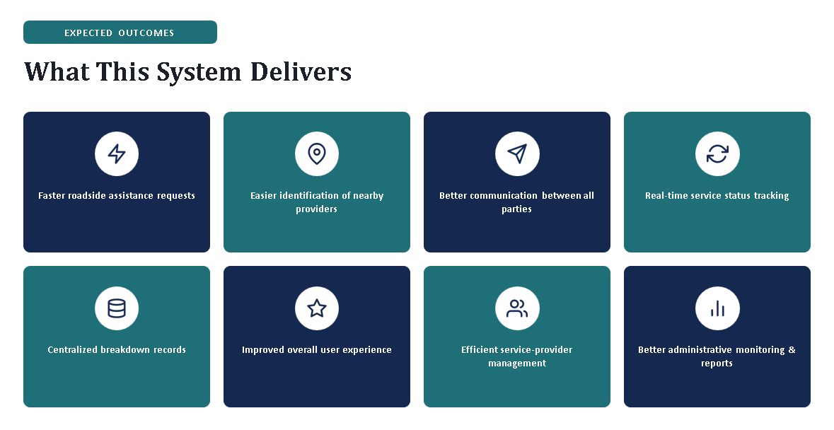

Slide 12
Conclusion
The proposed Smart Vehicle Breakdown Assistance System provides a centralized and location-aware platform that helps vehicle owners quickly connect with suitable roadside service providers, while real-time tracking improves coordination and transparency; in the future, the system can be enhanced with IoT-based vehicle monitoring, AI-based breakdown prediction, automatic fault detection, emergency SOS, online payments, live provider tracking, predictive maintenance, and insurance integration.

Slide 13
Reference
[1] I. M. Almomani, N. Y. Alkhalil, E. M. Ahmad, and R. M. Jodeh, “Ubiquitous GPS vehicle tracking and management system,” in Proc. IEEE Jordan Conf. on Applied Electrical Engineering and Computing Technologies (AEECT), Amman, Jordan, Dec. 2011, pp. 1–6.
[2] K. Iswarya, D. Devika, and E. Ranjith, “Road assistance system using GPS,” Int. J. Advance Research, Ideas and Innovations in Technology (IJARIIT), vol. 6, no. 2, 2020.
[3] “Mobile based solution for vehicle assistance,” in Proc. 2021 3rd Int. Conf. on Advancements in Computing (ICAC), 2021, pp. 31–36, doi: 10.1109/ICAC54203.2021.9671196.
[4] “Review paper on ‘On road vehicle breakdown assistance system,’” Int. J. Engineering Applied Sciences and Technology (IJEAST), vol. 4, no. 11, pp. 199–202, Mar. 2020.
[5] “On-road vehicle breakdown assistance finder,” Int. Research J. Modernization in Engineering, Technology and Science (IRJMETS), 2024.
[6] M. Usman, M. R. Asghar, I. S. Ansari, F. Granelli, and K. A. Qaraqe, “Technologies and solutions for location-based services in smart cities: Past, present, and future,” IEEE Access, vol. 6, pp. 22240–22248, 2018, doi: 10.1109/ACCESS.2018.2826041.

